Slide 1
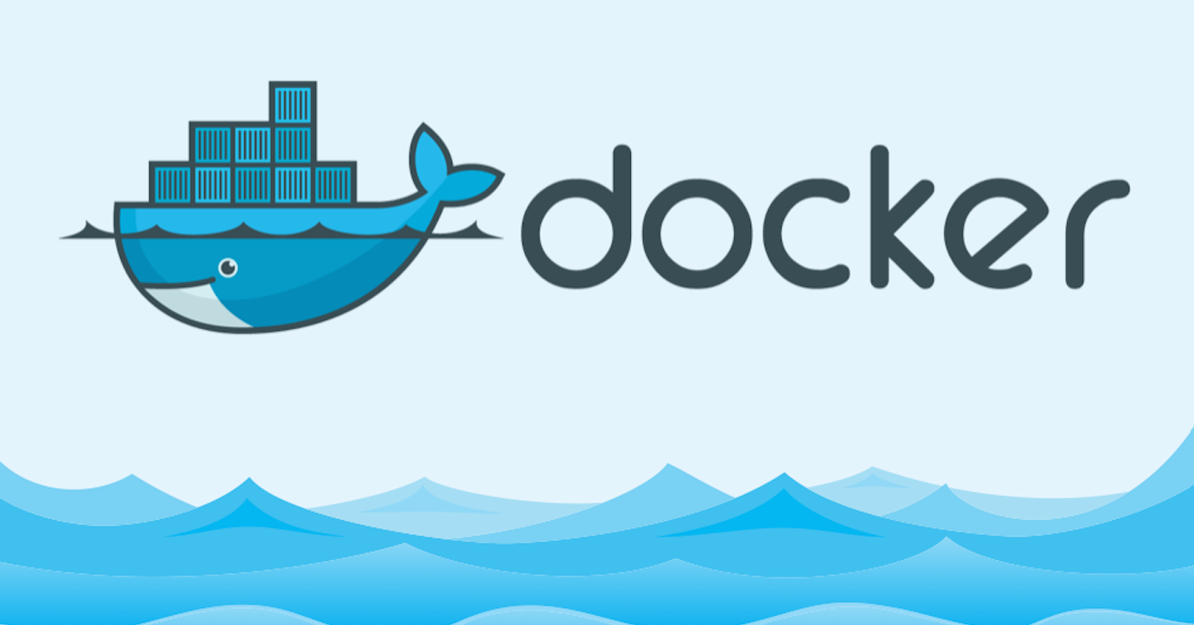
Docker Compose
The open platform to build, ship and run any application anywhere

Slide 2
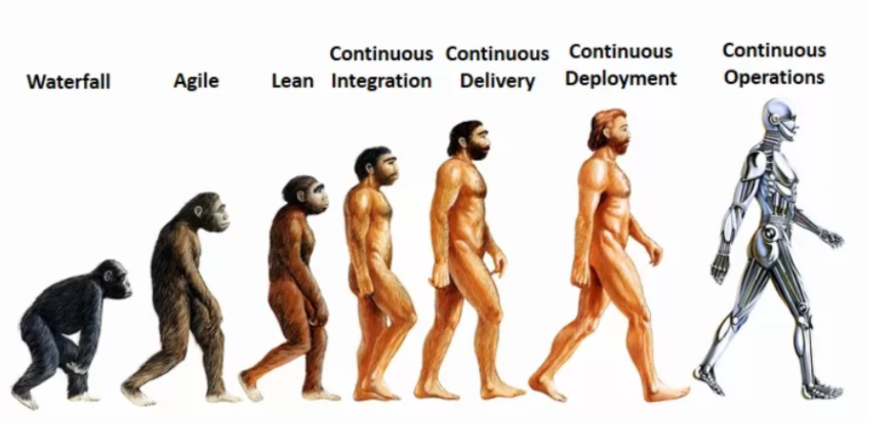
About me
14+ Engineering experience (Cisco Systems, VMware )
Continuous Operations freak and AWS enthusiast

Slide 3
Session Logistics
3 hours (exercising time included)
“Introduction to Docker” and Docker Fundamentals courses required
You will need:
Linux machine
Dedicated
VM
Cloud provided
Enthusiasm

Slide 4
Recap from “Docker Fundamentals”
Docker Layers
Docker Commit
Dockerfile syntax
CMD vs ENTRYPOINT
Docker TAG and PUSH
Volumes
Networking
Linking containers

Slide 5
Agenda
Docker-compose
Syntax
Docker compose commands
Exercise

Slide 6
Multi-container apps are a hassle.
Build images from Dockerfiles
Pull images from the Hub or a private registry
Configure and create containers
Start and stop containers
Stream their logs

Slide 7
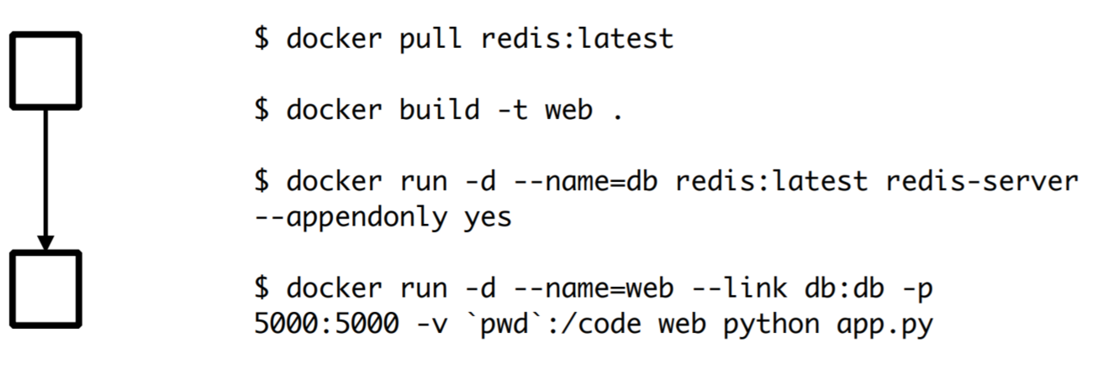
Multi-container apps are a hassle

Slide 8
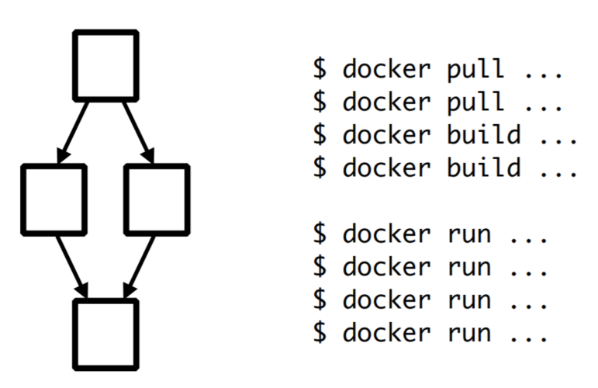
Multi-container apps are a hassle.

Slide 9
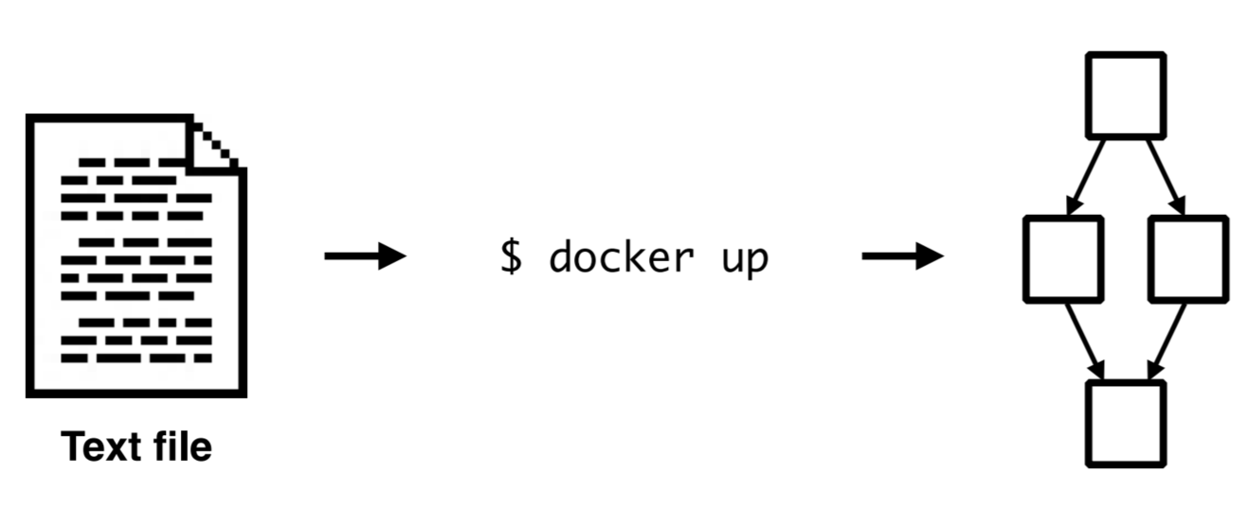
Docker Compose
Get an app running in one command

Slide 10
Native Docker API
The same API used by other Docker commands.
The same API used by other Docker tools.
The same API exposed by Docker Swarm.
Multi-container apps on multi-host clusters.

Slide 11
Built into the Docker client
New command: docker up
Enhanced commands: docker build, pull, run, start, stop, kill, rm...

Slide 12
Basic commands
Docker-compose
Up
Down
Scale
Build

Slide 13

Demo

Slide 14
app.py
from flask import Flask
from redis import Redis
app = Flask(__name__) redis = Redis(host="redis", port=6379)
@@app.route('/')
def hello():
redis.incr('hits')
return 'Hello World! I have been seen %s times.\n' % redis.get('hits')
if __name__ == "__main__":
app.run(host="0.0.0.0", debug=True) requirem

Slide 15
Dockerfile
FROM python:2.7
ADD . /code
WORKDIR /code
RUN pip install -r flask redis

Slide 16
Group.yml
name: counter
containers:
web:
build: .
command: python app.py
ports:
- "5000:5000"
volumes:
- .:/code
links:
- redis
redis:
image: redis:latest

Slide 17
Demo

Slide 18

Advanced example

Slide 19
References
https://github.com/docker/compose
Docker-compose reference guide
https://docs.docker.com/compose/compose-file/
Local Development with docker-compose by Heroku
https://devcenter.heroku.com/articles/local-development-with-docker-compose
Google ☺

